Slide 1
Environmental Statistics Part 1. Introduction/ Sampling Design
Eatontown, NJ
August 18, 2014
Notes:
Welcome to the Basic Environmental Statistics course.
Large-scale environmental site investigations in US started in 1970s as a result of new laws and regulations, such as National Environmental Policy Act (1970), Resource Conservation and Recovery Act or “RCRA” (1976), and Comprehensive Environmental Response, Compensation, and Liability Act or “CERCLA or Superfund” (1980).
Unlike previous studies, these site investigations entail large amount of data, which form the basis for remedial decisions, including delineating the extent of impact, determining the level of risks, and identifying the appropriate remedy.
Site-specific data, however, often display variations, which are characterized as complex, random-like, and/or erratic.
From the very beginning it became clear that the analyses of such site data requires the use of statistical techniques. This is the course devoted to the understanding of these techniques.

Slide 2
Introduction
Course objectives
Training
Focusing on strengths and weaknesses of common statistical applications
Empowering
Allowing NewFields’ scope of services to expand
Notes:
Welcome notes

Slide 3
NewFields Environmental Series
Part 1. Introduction/Sampling Design
1 day/Software: DOE’s VSP
Part 2. UCL and Background Analyses
2 days/Software: EPA’s ProUCL/Scout
Part 3. Univariate Techniques: ANOVA
2 days/Software: IBM SPSS
Part 4. Multivariate Techniques: PCA/PLS
2 days/Software: IBM SPSS
Part 5. Geostatistics
2 days/Software: ArcGIS Geostatistical Analyst

Slide 4
Basic Introduction

Slide 5
Why do we need statistics in environmental assessments?
Complex variability of field data
Source uncertainty
Heterogeneous soil, rock and sediment media
Complex hydrologic conditions
Partially known geochemical processes
Laboratory uncertainties
Uncertainty & Variability ~ Random variables
Statistics is the mathematical tool to process and analyze random variables
Notes:
Why do we need statistics in environmental assessments?
As you are well aware, there is much variability in nature:
The media in which we find contamination, mostly soil, rock and sediment are naturally heterogeneous, always a mixture of different types and sizes of solid material.
Hydrologic cycle, i.e. continuous movement of water in air, surface and subsurface, adds additional variability to the distribution of contaminants.
In addition, its hard to observe, measure and understand the natural processes that affect chemicals in the environment.
Dispersion, dissolution, contaminant transport are at best, only partially known and modeled.
Nature and the environment are well, naturally variable. (pun intended)
Also, the samples we collect in the field, and the measurements we conduct in the laboratory are never perfect.
The point is that there is much variability and uncertainty inherent in environmental processes. As a result, our typical site-specific data contain large amounts of unexplainable variations. So even when we have many samples in a small site, it is hard to exactly predict the level of concentration at an un-sampled location.
These uncertainties, although not intrinsic, are due to our limited knowledge. So from our point of view, our collected data have the properties of a random variable.
And Statistics is the best and the only techniques to process such random variables. Mathematics deals with “deterministic” variables, i.e. for a given input there is only one outcome. Statistics, on the other hand, deals with “random” variables, i.e. for a given input there are multiple outcomes possible. Each outcome has its own likelihood of occurrence or probability.
Statistics provide tools for modeling and analyzing random variables in order to make inferences. Such inferences allow us to determine whether we have adequate data, whether we have acceptable risks, and whether we have attained our cleanup goals.
Given the importance of these decisions, we need to love and embrace Statistics. So, let’s describe some common applications of Statistics in environmental site investigations.

Slide 6
Statistics and Environmental Applications
Statistics has been an integral part of environmental site investigations since 1970s when large-scale sampling activities were initiated throughout the United States
In environmental applications, statistics is used in a variety of problems, such as:
Sampling Design
Background Analysis
Attainment of Cleanup Goals
Risk Assessment
Compliance Monitoring
Forensic Chemistry
Notes:
In environmental site investigations, Statistics is used in a variety of problems, such as:
Site Characterization
Sampling Design
Attainment of Cleanup Goals
Risk Assessment
Compliance Monitoring
Let’s explore each of these problems through examples.
Ask participants to share their experiences, when discussing the above problems.

Slide 7
Range of Statistical Techniques (From Simple to Complex)
Exploratory Tools
Descriptive Statistics: mean, standard deviation
Graphic Tools: Histogram, box plot, probability plots
Comparative Tools
Hypothesis Tests
Analysis of Variance (ANOVA); ANCOVA and Repeated Measures ANOVA
Correlation (Multivariate) Tools
Regression Analysis
Principle Component Analysis (PCA) and Partial Least Squares (PLS)
Spatial Tools
Geostatistics
Notes:
So far we have investigated the common statistical procedures used in environmental applications, including:
Exploratory Tools, such as
Descriptive Statistics: mean, standard deviation
Graphic Tools: Histogram, box plot, probability plots
Comparative Tools, such as
Two sample tests
However, there are many more advanced statistical techniques that are used in
Environmental applications, such as
Analysis of Variance (ANOVA)
Correlation (Multivariate) Tools, such as
Regression Analysis
Principle Component Analysis
Spatial Tools, such as Geostatistics
Full discussions of these techniques are beyond the scope of this course, however, I will try to highlight some of them through an example.

Slide 8

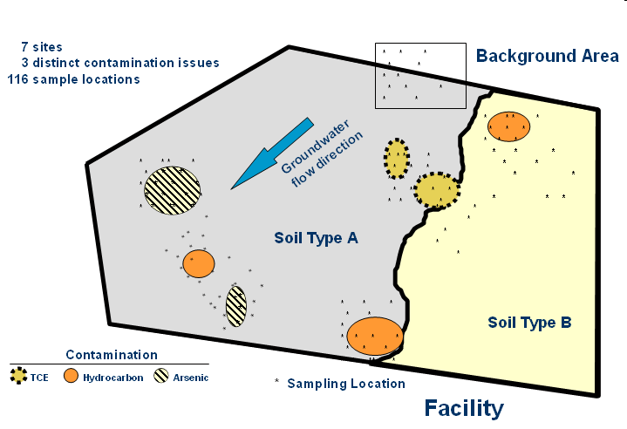


Distinct Features of Environmental Applications
Typical Statistical Application:
Decision are made based on random (unbiased) data
Example: Clinical trials
Random samples are often not representative ⇒ Sampling Error
Typical Environmental Applications:
Decisions are made based on judgmental (biased) data
Example: Site investigations
Data are often aimed to be representative
New Drug Placebo
Group A Group B
Be aware of limitations of statistical procedures
Notes:
In most instances, judgmental (biased) data collected in environmental applications are inconsistent with basic assumptions of a typical statistical analysis.
Therefore, prior to the use of any statistical procedure, the impacts of judgmental data must be assessed in order to avoid unreliable and/or inconclusive results.
Open discussions about such problems, such as site data sets that are much larger than the background data sets leading to false positives….

Slide 9
Statistical Vocabulary

Slide 10
Statistical Modeling
Random variable can acquire more than one value due to natural variability and/or uncertainty
Population is the set of all the values of the random variable
Distribution defines the likelihood of occurrence of each value of the random variable.
Histogram/Discrete; Probability Mass Function
Continuous; Probability Density Function
Notes:
A Random Variable can acquire more than one value under a given condition. This can be due to either natural variability or uncertainty.
An example of natural variability is the range of metal background concentrations in soil. Uncertainty, on the other hand, is mainly driven by the limits of our knowledge. For example, estimate of concentration at an un-sampled location contains uncertainty.
Uncertainty can be reduced with increased knowledge, such as additional sampling. However, “Variability” cannot be reduced with increased sampling; it simply gets better defined with more samples.
As we collect more information about a particular random variable, such as soil concentration, we find that the variable has a certain range of values, from a minimum to a maximum, and that some values will occur more often, and some less often.
The total set of all possible values of a random variable is referred to as its Population. For example, when we are measuring height of students in a given high school, the population is the collection of the heights of all students in that high school.
A random variable is modeled by its Distribution. Distribution defines the likelihood of occurrence of each outcome of the random variable. The simplest distribution involves only two possible outcomes, a binary distribution, such as head-or-tail or a 50-50 chance. Dice has 6 outcomes, each with 1/6 likelihood to occur.
As the number of our outcomes increases, we use histograms, as shown on the left. In this example, the random variable has 11 outcome intervals or “bins”. The height of each bar corresponds with how many occurrences are within a certain interval.
The histogram is a discrete probability distribution function/model, as it models the distribution of a random variable, organized into discrete intervals. This function is sometimes referred to as the “probability mass function.”
A continuous probability function model portrays the same information, but assumes that there are infinite number of outcomes, rather than discrete intervals. This function is sometimes referred to as the “probability density function.”

Slide 11
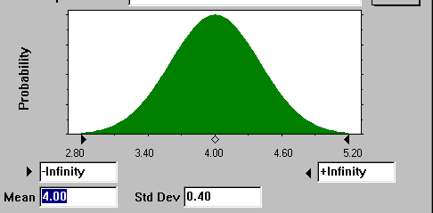
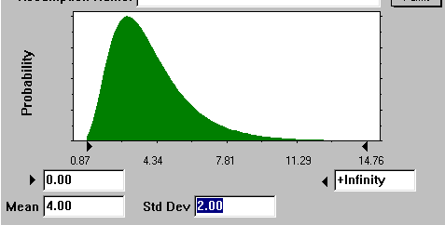
Common distribution models
Normal (Gaussian) distribution
Symmetric
Central Limit Theorem: Sum of random variables tends to normal distribution regardless of the distribution of constituent variables
Lognormal distribution
Random variables whose logarithms are normally distributed
Skewed
Common for environmental parameters
Notes:
There are many mathematical functions that can be used to model a continuous distribution or discrete distribution function. The most common probability density function is the “normal”, or Gaussian distribution shown on top here. This distribution describes a “bell-shape” distribution that is symmetrically distributed about a central point, or average. This distribution is named after the German scientist Carl Friedrich Gauss (1777-1855). Until few years ago, Gauss’s portrait adorned the face of the 10 Deutschmark bills. So you can see the importance the German give to this genius.
The importance of the normal distribution is attributed to the “Central Limit Theory,” which states that any sum of random variables has a tendency to normal distribution regardless of the distribution of the constituent variables.
Important example: “Average” or “mean” concentration is the sum of measured concentrations divided by the number of measurements. This “average” has a tendency to normality even when the individual concentrations have skewed (asymmetric) distribution.
In fact, in most field cases, concentration data have highly skewed shape, which is usually modeled with the use of a log-normal distribution. This skewness can often be the result of the way we collect our data, i.e. few samples from source contamination, many samples from the contamination boundary areas, along with few “background” samples.
Important Note: When you are working with a variable, make sure that you are using its appropriate distribution. Examples:
(1) If you are dealing with “UCLs” in risk assessments, you are working with “mean” concentrations. Remember that regardless of the distribution individual concentration data, the mean concentration has a tendency toward normal distribution. This tendency becomes strong when you have more than 20 measurements with low variability.
(2) On the other hand, if you are dealing with “upper threshold values of background concentrations,” then you working with the distribution of the individual concentration data. In almost all cases, this distribution is skewed (looking like log-normal distribution).
We will discuss Lognormal distributions in more detail later.

Slide 12
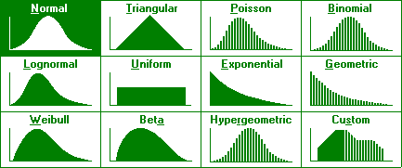
Distribution models
Source: Crystal Ball Version 4
Notes:
There are many other mathematical distributions in addition to the Normal and Lognormal distributions used to model distributions of random variables. Some are pictured here, courtesy of the Crystal Ball software program.
The only ones worth mentioning at this time are the Triangular and the Uniform and the Beta distributions, as you may see these in environmental applications.
The Uniform distribution simply means that any value within the defined range is equally likely to happen. Like the rolling of a dice, each number has an equal chance of occurring.
The triangular distribution is also intuitive, where there is one value most likely to occur, with uniformly decreasing probability to the minimum and maximum values.
The Beta function offers a flexible model for skewed data. Recent work by EPA shows the advantages of this function versus log-normal model.
These functions are commonly used to model the variability and uncertainty distribution of environmental data. Each distribution has one or more “parameters” that define the shape and location of the distribution.
For example, the normal distribution has two parameters, i.e. the mean and the standard deviation. Available data are used to estimate these parameters, which are often referred to as “descriptive summary statistics”.

Slide 13
Descriptive summary statistics
Central tendency:
Mean: Arithmetic average, μ
Median: 50 percentile value
Mode: Value with the highest occurrence frequency
Dispersion, spread:
Standard deviation σ; (variance, σ²)
Coefficient of variation (CV) = σ/μ
Symmetry:
Skewness: Measure of asymmetry (= 0 for symmetric distributions)
Distribution tails:
Minimum/maximum
P^{th} percentile or quantile
25 percentile, 75 percentile (quartiles)
Kurtosis
Notes:
The most common summary statistic is related to the Central Tendency of the distribution model. There are three common measures of central tendency, which are the mean, the median and the mode.
The mean is the arithmetic average of all population units. The median is the 50th percentile, meaning 50% of the population values are less than the median and 50% are greater. The mode is the value that occurs the most, regardless of what percentile it is.
The next important summary statistic measures the Dispersion or Spread of the distribution model. The Standard Deviation, which is the square the variance, quantify how dispersed the data are. The greater the standard deviation, the more widely spread the distribution.
The mean and the standard deviation are the two most commonly used parameters to describe a distribution. The coefficient of variance is computed by dividing the standard deviation by the mean, and is useful as a relative measure of dispersion.
Other lesser used, but still useful statistics are related to the Symmetry and Tails of the distribution model. Among these maximum and minimum, as well as percentiles are often calculated in environmental site investigations.
Percentile is the value of a random variable below which a certain percentage of the variable fall. For example, 30% of the data values lie below the 30-percentile.
Quantile is another term used for percentile.
25 and 75 percentiles are sometimes referred to as the first and third “quartiles”, respectively.

Slide 14
Sample Distribution Model
Parametric – Fitted models
Non-Parametric – Sample set distribution, as is
Parametric
Non-Parametric
Notes:
Sample distribution models can be either parametric or non-parametric.
Parametric model is a known distribution that is fitted to the sample data. Such a model is stable, but not flexible. Sometimes, this model is called the underlying distribution.
Non-parametric model is the sample distribution without any modification – as is. This model is flexible, but unstable, i.e. can change each time you collect more data.
The choice of the modeling approach can impact the results of the analysis.

Slide 15
Estimates of Central Tendency
Sample mean:
is an estimate of μ
μ = True Population Mean
Sample median:
50% less than, 50% greater than
Sample Median is an estimate of the true population median
Underlying Assumption: Each observation is a random (unbiased) and independent representation of the population.
Caution:
Environmental data are rarely collected randomly. Also, often data collected near areas of interest exhibit correlation, i.e. not independent.
Notes:
Statistical properties of the true population can be estimated based on the sample set results. Among these the most important property is the “Central Tendency.”
Remember even when you were in primary school, the first question after each test was: “what is the average grade?” You intuitively knew that the average is an important indicator on how good you have done: above-average is good, below average is bad. In statistical jargon you where trying to determine the central tendency of the class grade.
In environmental site investigations, central tendencies are also very important. For example, the risk posed by a site is directly proportional to the average contaminant concentrations.
In environmental applications, the central tendency of a random variable is usually estimated by either “the mean” or “the median.”
The sample mean is just simply the arithmetic average of the sample set. Statisticians are careful to differentiate between the mean of the population and the sample mean. The sample mean is written as X-bar, while the population mean is written as the Greek letter “μ” (Mu). The Sample Mean is as an estimate of the population mean, μ.
The sample median is the middle value in the sample set, i.e. 50% of samples values are less than or equal to the sample median. The sample mean is also an estimate of the true population median.
The reliability of the sample mean and median as estimates of true population mean and median depends on: (1) the variability of sample values and (2) the number of measurements, n, which often referred to as the “sample size”.

Slide 16
Estimates of Sample Variability
Sample Standard Deviation:
s is an estimate of σ
σ = Standard Deviation of Population
Coefficient of variation:
Notes:
The variability of sample values are measured by their “standard deviation”.
The sample standard deviation is a measure of the spread of or dispersion within a set of sample values. The sample “variance” is the square of the sample standard deviation.
The sample standard deviation is calculated as the square root of the sum of the squared deviations of sample values from their average divided by one less than the sample size.
The sample standard deviation is given the symbol “s”, to differentiate it from the population standard deviation denoted by the Greek letter sigma (σ). The sample standard deviation is an estimate the true population standard deviation.
The sample coefficient of variation is the ratio of the sample standard deviation over the sample mean. Sample sets with coefficient of variations less than 1 have low variability.
As noted before, the reliability of the sample mean depends on the variability of the sample set. If the sample coefficient of variation is low, then a small representative sample set can yield a reliable average. In contrast, for sample sets with elevated coefficients of variation (say, greater than 1), large sample sizes may be needed before a reliable estimate of the mean can be made.

Slide 17
Accuracy of Estimate: Standard Error of the Mean
Data Variability: Sample Standard Deviation
Standard Error of Mean
Excel
=STDEV(cell array)
Excel
=STDEV(cell array)/SQRT(COUNT(cell array))
Notes:
To compute the standard error of the mean, we first need to calculate the sample standard deviation, which is the measure of sample data variability.
The histogram in this slide provides you with a visual depiction of sample data variability. In fact, the majority of data are at concentrations below 200 ppm, with few elevated concentrations in excess of 400 ppm. Note that this histogram doesn’t look like any theoretical distribution models that we saw earlier. Unfortunately, most of the time, our field data have histograms even more complicated that the one shown here. So how can we model our field data? This is another challenge that we always encounter in environmental applications. We will discuss in this challenge later.
Getting back to our example, the sample standard deviation is computed by summing the individual square deviations of each measurement from the sample mean, and then dividing the sum by the sample size -1. In this example, it yields a standard deviation of 155 ppm.
Try this in our Excel file (Example.xls) by typing: “=stdev(b2:b21)”.
Now, the precision of the sample mean is calculated as the ratio of the sample standard deviation over the squared sample size, which results in a standard error of 35 ppm. So we can say that our estimated sample mean is 181+35 ppm.
Try this in our Excel file by typing: “=stdev(be:b1)/sqrt(19)”

Slide 18
Confidence Interval (CI)
Confidence Interval is a range, about an “estimate”, which if repeated, has a specified probability of containing the true population value.
Confidence Interval is often used as a measure of the reliability of the estimate
For example, 95% confidence interval of the sample mean is a range of values which if repeated has a 95% probability of containing the true mean.
Significance (α) = 1 - confidence
For example, a 95% confidence corresponds to a 5% significance
Notes:
The sample mean or standard deviation, like any estimate is prone to uncertainty. Even when you have a large site-specific data set, you can never be 100% sure about your estimated exposure concentrations. Statistics recognizes this dilemma and provides procedures to quantify the uncertainty associated with the sample estimates.
In many instances, this uncertainty is quantified by a confidence interval. This is the range around an estimate that has a specified probability of containing its true population value.
The sample mean is an “estimate”, i.e. not a 100%-sure value of the true population mean. Confidence interval quantifies the range of values that contain the true population mean at a specified probability.
For example, a 95% confidence interval implies that we are 95% confident that this range contains the true population mean. This means that if we repeat sampling n measurements, 95% of time the sample mean falls within the computed confidence interval. In other words, 5% of time the sample mean falls outside the interval. This failure rate is referred to as the “significance”.
By definition, significance = 1 – confidence.

Slide 19
UCL of the Mean Based on Central Limit Theory
Central Limit Theory: any sum of random variables tends to normality regardless of the distribution of its constituent random variables.
The sample mean of a large sample set (say n>30) with low variability (say CV<1) can be assumed to be normally distributed regardless of the distribution of sample values. Under this condition:
Source: RAGS….. (EPA 1989)
Notes:
We learned that it is easy to compute the UCL of the mean if our data are normally distributed. Now, how about skewed non-normal datasets?
Let me remind you that in almost all environmental applications, our site data are not normally distributed. In fact, I cannot recall a single sample data set from an impacted site that was normally distributed. Often site data have complicated histograms that don’t fit any of our typical distribution models. What do we do under these conditions?
Statisticians have provided a partial answer to our problem by the “Central Limit Theory,” which is one the few theories of statistics. According to this theory, any sum of random variable tends to normality regardless of its constituent random variables.
According to the Central Limit Theory, the sample mean, which is the sum of n sample values divided by n, also tends to normality regardless of the distribution of the samples values!
This tendency becomes strong as the number of samples increases, or the sample variability decreases. So as the number samples increases (say n>30), while the sample variability remains low (say CV<1), one can assume the sample mean is normally distributed regardless of the sample set distribution.
This is, however, only a partial answer. How about cases when we have limited data, or high variability? This leads us to other distributional assumptions about the sample mean.

Slide 20
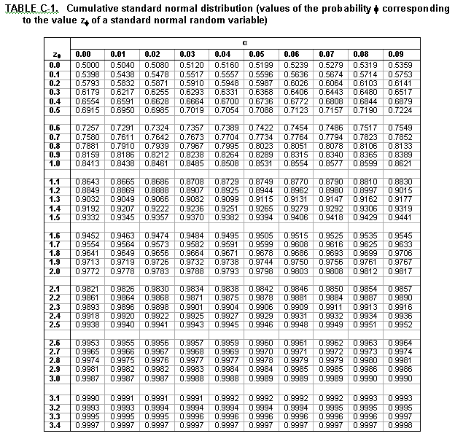
z_{50%} = 0.00
z_{80%} = 0.84
z_{90%} = 1.28
z_{95%} = 1.64
z_{99%} = 2.33
Excel
=NORM.INV(prob, mean, st dev)
Z_{95%}
=NORM.INV(0.95,0,1)
Notes:
Standard normal variate or “z” is either read from a table, or automatically provided by a software. Consider an old-fashioned standard normal variate table, which contains the cumulative probabilities of normal variates with a mean of zero and a unit standard deviation.
For example, to find out z_{95%}, first locate a cumulative probability closest to 0.95, that is “0.9495”. From this cell move to the cell in the first column and read the z_{95%} up to its first decimal, that is 1.6. The second decimal is provided in the cell along the first row above the “0.9495” cell, which is 0.04. So the z_{95%} is 1.6+0.04, or 1.64. 1.64 is a normal value which > than 95% of normal variates with a mean of 0 and standard deviation of 1.
I have also listed some other commonly used standard normal variates, such as z_{90%}. So if you multiply the standard error of the mean by 1.28, and add it to the sample mean, you will get the 90%UCL.
Almost every statistics text book has a standard normal variate table. In Excel software, the standard normal variate is obtained like by typing: “=norminv(.95,0,1)”, where 0.95 is confidence, 0 =mean, and 1 = standard deviation.
(Ask the participants to open their Excels and try this function.)

Slide 21
UCL of the Mean Normal, but Limited Data
If sample values are normal, but there are elevated uncertainty due to limited data (say n<30), Student’s t should be used as:
where, t_{95%,n-1} = Student’s t value with cumulative probability of 95% and n-1 degrees of freedom
Student’s t is more conservative in order to account for uncertainty in sample standard deviation due to limited data.
Excel
=T.INV(confidence, n-1)
t_{95%}, n = 10
=T.INV(0.95,9) = 1.83
Notes:
In previous computations, we assumed that our sample standard deviation “s” is accurate and precise. However, if there are limited data, the sample standard deviation is prone to uncertainty. Student’s t takes this uncertainty into account and provides estimates of UCL which are more conservative.
“Student” was the pseudonym of Sir Ronald Aylmer Fisher, (1890–1962), the famed British eugenicist, evolutionary biologist, geneticist and statistician, who has been described as "The greatest of Darwin’s successors” and the “genius who almost single-handedly created the foundations for modern statistical science.” He, however, was quite humble, and always referred to himself simply as a “Student.”
Student’s t is especially applicable to sample sets with fewer than 30 measurements. Values of Student’s t values depends on the specified confidence and sample size, which is measured in term of its degrees of freedom, or sample size -1.
Student’s t can be obtained from tables, which are included in almost every statistics textbook, or provided by a software. In Excel, you can obtain t-values by typing “=tinv(.10,19)”, where .1 is the “two tail” significance, and 19 is the sample size -1.
Remember that in most environmental applications, we are only concerned about exceeding a standard, so our significances are usually “one-tail”, i.e. we don’t mind to be significantly below a standard, only when we are above it that worries us.
Converting two-tail to one-tail equivalent values is simple, because we are assuming a symmetric normal distribution. So the two-tail significance of 0.10 corresponds to a one-tail significance of 0.5, and a one-tail confidence of 0.95. So heretofore, the term confidence implies a “one-tail” confidence.
Now in Excel try “tinv” and “norminv” for 95% confidence levels for sample sizes of 10, 100, and 1000. Repeat the computations for a 90% confidence.
Student’s t is a conservative measure of the normal variate, and as we obtained more data, it approaches the normal variate. This is shown through an example in the next slide.

Slide 22
Normal “z” vs Student’s “t”
Standard normal z
Student’s t
Notes:
Now let’s consider an example. Two sample sets are considered with the same sample mean and standard deviations. As will be discussed later, due to the small CV<<1, we can assume that the sample mean of both sets are normally distributed.
The first one has 100 measurements (>>30), and thus, the normal variate can be used. This variate at 95% confidence is 1.64, resulting in a UCL of 153 ppm.
The second set has only 10 measurements. For this set, the Student’s t should be used to account for its limited sample size. The Student’s t at 95% confidence and with only 9 degrees of freedom, is 1.86. Note that this t value is 11% higher than its corresponding normal variate due to the limited sample size of the second set. The resulting UCL is further augmented due to the higher standard error, resulting in 162 ppm.
In the above example, the limited number of measurements in the second set led to an increase the UCL’s safety factor from 3 ppm for 100 measurements to 12 ppm for 10 measurements, a four-fold increase in the UCL safety factor.

Slide 23
Important Reminder: “Percentile” versus “UCL”
95% Percentile =449 ppm
Percentiles are associated with individual sample values
Typically used in background analysis
95% UCL of Mean = 241 ppm
UCLs are associated with estimated values
Typically used in risk assessment
436
5%
Excel
=PERCENTILE(cell range,0.95)
239
5%
Notes:
At this point, it very important to point out that 95%UCL and 95%Percentiles are not the same. But they are often confused.
Percentiles are associated with “individual” sample values. The 95% percentile represents the value of the individual measurement, which is greater than 95% of possible measurements. Percentiles are often used in in background analysis. In this example, for a random variable, assuming to be normally distributed, with a mean of 181 ppm and a standard deviation of 155 ppm, the 95%precdentile is 449 ppm.
Try this in Excel by typing “=percentile”.
In contrast, UCLs are associated with “estimated” values, such as the sample mean, which in this example is only 241 ppm. Do not confuse these two measures.
UCLs are typically used in risk assessment, because the level of risk is proportional to the “mass” of contaminants exposed to a receptor. “Mass” is directly related to the “mean” concentration, and not individual measurements. So RAGS requires the use of UCLs as a conservative measure of the computed average concentration.

Slide 24
Excel Exercise
Lead soil concentrations
Tasks:
Calculate mean, UCL and Percentiles
Histogram (raw data)
AVERAGE
STDEV
NORM.INV
T.INV
PERCENTILE
Histogram (log data)

Slide 25
Hypothesis Testing

Slide 26
Hypothesis Testing
Why use it? To aid in decision making, e.g.:
Is the site contaminated?
Are site data significantly higher than the background?
Is there a declining trend in the groundwater data time series over time?
What are the advantages?
Quantitative; Consistent; and Repeatable
Notes:
Why do we use hypothesis testing? In environmental applications, there are many instances that we have to make a decision based on a yes or no to a specific question. For example:
Before computing the exposure concentration, we are faced with a question: Are sample data normally distributed?
Are site data significantly higher than the background? Is the site impacted or simply part of background condition?
Is there a trend in the groundwater data time series over time? Is there a release or not?
Did a groundwater treatment system reduce groundwater pollution levels? Is the pump-and-treat system effective or just a waste of time-and-money?
All these questions may be answered through hypothesis testing. The main advantages of these tests are: (1) they are quantitative; (2) they are consistent, and (3) they are repeatable. So others can reach the same conclusion, if they repeat the process.

Slide 27
Hypothesis Testing
Provides a yes-no answer to a specific question.
Examples:
Is the site contaminated or clean? Yes or No?
Are site data greater than background? Yes or No?
Takes into account the
Variability of data
Uncertainty of statistical estimates (e.g., sample means, variances, proportions, distributions, trends)
Notes:
Hypothesis testing provides a yes-no answer to a specific question.
Examples:
Are sample data normal? Yes or No?
Are site data greater than background? Yes or No?
Hypothesis testing takes into account the: Variability of data; and Uncertainty of statistical estimates (e.g., sample means, variances, proportions, distributions, trends)

Slide 28
Null and Alternative Hypotheses
Null hypothesis (H_{o}):
A statement that is driven by our site knowledge or defined by regulations
Hypothesis testing is geared toward rejecting the null hypothesis
Example: Site is contaminated
Alternative hypothesis (H_{a}):
The opposite of the null hypothesis
Example: Site is clean
Notes:
Before you conduct a test, you need to define your null hypothesis. The null hypothesis or Ho is a statement that is consistent with your current state of knowledge. In environmental applications, this knowledge is referred to as the “site knowledge”.
Ho is not be an arbitrary choice. It must reflect your site knowledge.
Without an adequate site knowledge, testing of a null hypothesis is useless.
Hypothesis testing is geared toward rejecting the null hypothesis
Example: Chemical X in Site Y is background
The alternative hypothesis or Ha is the opposite of the null hypothesis.
If Ho is rejected, then Ha must be adopted.
Example: Chemical X in Site Y is a COPC.

Slide 29
Example of Hypothesis Testing: Attainment of Cleanup Goals
EPA 1989 Guidance
U.S. EPA, Statistical Methods for Evaluating the Attainment of Cleanup Standards, Vol. 1: Soils and Solid Media. EPA 230/02-89-042. Washington, DC: Office of Policy, Planning, and Evaluation. 1989.
Null Hypothesis H_{o}: Site is Contaminated
Reject H_{o}, if 95%UCL<C_{s}
“Reject-Support” or RS Testing
Notes:
Next few pages cover a common example of hypothesis testing, i.e. evaluating the attainment of cleanup standards.

Slide 30
Decision Errors and Test Power
Decision Based on Data
Site is
Contaminated
“H_{o}”
Site is
Clean
“H_{a}”
Site is Contaminated
Correct:
Confidence
Type I Error:
False Positive
α
True
State
Site is
Clean
Type II Error:
False Negative
β
Correct
(Test Power)
Notes:
True State are the actual conditions, such as Site is clean. Our decisions are based on our sample data. So we can make two errors: Type I and Type II with likelihood of α and β, respectively.
A good test is a test whose sum of these error are minimized.
Note that sometimes you may get tempted to design a test that favors one error over another. But there is no trade off between these errors, i.e. you cannot design a reliable test that favors α over β, or vice-versa.
For example, imagine that we set α=0.0001%. This means that the difference between our site mean concentration must very large before we call the site contaminated.
Some people may prefer such results, but the problem is that under this scheme, there will a very high likelihood that truly impacted sites will go unnoticed. So this test is inherently flawed and unreliable.
In summary, a good test has a minimum α+β. In contrast, a test that has a large α or β is inherently unreliable, and should be avoided at all cost.

Slide 31
Significance and Confidence
α = False Positive = Type I Error
Probability of incorrectly rejecting the null hypothesis
Also known as “significance level”
Always defined by convention to be 10, 5, or 1%
1- α = Confidence
β = False Negative = Type II Error
Probability of incorrectly not-rejecting (accepting) the null hypothesis
Usually selected to be higher than α, such as 10 or 20%
Power = 100% – β
Probability of correctly rejecting the null hypothesis
Notes:
Remember that in a hypothesis test, you either reject or not-reject a null hypothesis. The significance and confidence of any hypothesis tests is directly related to the type of errors that can be made.
α = False Positive = Type I Error; This is the probability of incorrectly rejecting the null hypothesis. Also known as “significance level.” The tolerable level of false positive is always defined by convention to be 10, 5, or 1%.
This is an error that you are willing to make in order to ensure the conservative nature of your analysis. 1-α is defined as “confidence”.
β = False Negative = Type II Error; This is the probability of incorrectly not-rejecting (accepting) the null hypothesis. This is the error that regulators are especially concerned about.
In cases, where small β requires an infeasible number of samples, it is set at higher rate than α, such as 10 or 20%
Test Power = 100% – β; This is the probability of correctly rejecting the null hypothesis.
Next slide shows these errors in a graphical manner.

Slide 32
Two-sample Hypothesis Tests
Suspect Difference | Test | Comparison | Type
Uniform Difference | Wilcoxon Rank Sum (WRS) | Median | Non-parametric
 | Gehan | Median | Non-parametric
 | Student’s two-sample t-test | Mean | Parametric
 | Satterthwaite t-test | Mean | Parametric
Tail Difference | Slippage | High concentrations | Non-parametric
 | Quantile | High concentrations | Non-parametric
 | Two-sample test of proportions | Percent of measurements above a given cutoff | Non-parametric

Slide 33
Effect of Null Hypothesis on Decision Outcomes
Conservative Approach:
H_{o}: Non-compliance/Site is unacceptable (dirty)
Action
Level
UCL<Action Level
Implies “Compliance”
LCL
UCL
0
True Mean Concentration

Slide 34
Effect of Null Hypothesis on Decision Outcomes
Conservative Approach:
H_{o}: Non-compliance/Site is unacceptable (dirty)
Action
Level
UCL>Action Level
Implies “Noncompliance”
LCL
UCL
0
True Mean Concentration

Slide 35
Effect of Null Hypothesis on Decision Outcomes
Common Approach:
H_{o}: Compliance/Site is acceptable (cleanup)
Action
Level
LCL<Action Level
Implies “Compliance”
LCL
UCL
0
True Mean Concentration

Slide 36
Effect of Null Hypothesis on Decision Outcomes
Common Approach:
H_{o}: Compliance/Site is acceptable (cleanup)
Action
Level
LCL>Action Level
Implies “Noncompliance”
LCL
UCL
0
True Mean Concentration

Slide 37

Application: Site v Background Tests
NAVFAC Guidance Documents, Section 4
Test type depends on:
Impact hypothesis
Site-wide
Localized
Parametric v. non-parametric procedures
<http://enviro.nfesc.navy.mil/erb/restoration/methodologies/main.htm#DE>
Notes:
NAVFAC provides a comprehensive guidance for background analysis.

Slide 38
Sampling Design

Slide 39
Sample Size and Test Power
More measurements are needed, if desired:
α ⇓ = Confidence ⇑
β ⇓ = Power ⇑
Test resolution ⇑ = Minimum detectable difference for correctly rejecting the null hypothesis at the given Power ⇓
Example: You want to be 90% sure that you will identify a COPC, if its site mean concentration is more than 15% greater than its background mean concentration
Notes:
For a reliable test, more measurements are required, if:
Its Type I error or significance decreases (In other words, its confidence increases)
Its Type II error decreases (in other words, its power increases)
Test power is related to the desired resolution of the test, i.e. the “Minimum detectable difference for correctly rejecting the null hypothesis”
Example: You want to be 90% sure that you will identify a COPC, if its site mean concentration is more than 15% greater than its background mean concentration

Slide 40
Decision Making
Cutoff
If Mean Concentration < Cutoff
Site is Clean
If Mean Concentration ≥ Cutoff
Site is Dirty
Mean
Concentration

Slide 41
Determining Cutoff
Sample mean is not the true mean
Reliability of sample mean depends on the sample size
If sample size is very large (i.e. very confident about the reliability of sample mean), then Cutoff = Cleanup Standard (C_{s})
If not, Cutoff is set at a value less than the cleanup target to accommodate the potential unreliability of the observed sample mean (safety factor)

Slide 42
Null Hypothesis
Null Hypothesis (H_{o})
μ = C_{s} (limiting case)
Reject H_{o}, if
False Positive
“α”
Type I Error
Incorrectly rejecting the null hypothesis
Site is declared clean, when it is contaminated
Cutoff
Mean
Concentration

Slide 43
Alternative Hypothesis
Determining Alternative Level (μ₁):
μ₁ has to be less than C_{s}
Suggested values:
Detection limit
Background threshold concentration
Fraction of C_{s}

Slide 44
Power
P = 1-β
Correctly rejecting the null hypothesis
The Site is declared clean, when it is clean
Alternative Hypothesis
μ₁<C_{s}
False Negative
“β”
Type II Error
Incorrectly accepting the null hypothesis
The Site is declared contaminated, when it is clean
Cutoff
Mean
Concentration

Slide 45
Alternative Hypothesis
μ₁
Null Hypothesis
C_{s}
Cutoff
β
α
Mean
Concentration

Slide 46
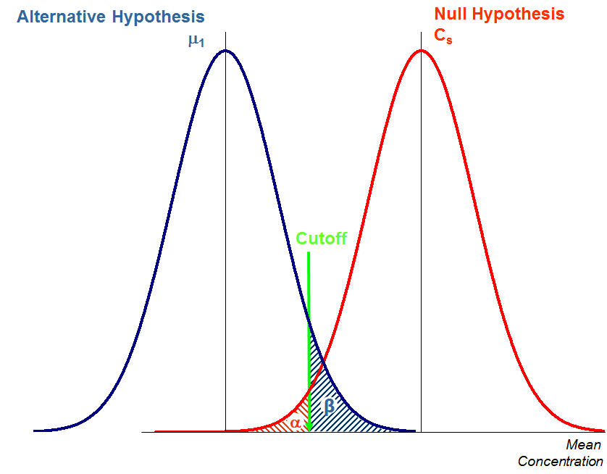
A priori or “Statistical” Sample Plans (Assumptions and Limitations)
Notes:
The hypothesis test structure can be used to determine the minimum number of samples necessary to achieve a pre-determined α and β.
As EPA technical document (Singh et al. 1999) indicates: “It is very well possible that it may not be feasible to achieve the desired performance parameters without taking an enormous number of samples. This is especially true when a lognormal model is assumed. Therefore, it becomes necessary to find a balance between the choice of performance parameters (error rates, power) and the number of samples needed for hypothesis testing. For example, when more (or less) samples are taken, then the gain (or loss) in levels of performance standards for the various approximate formulas need to be investigated. Keeping some of these practical considerations in mind, the regulators may have to settle for reduced values of performance standards.”

Slide 47
Alternative Hypothesis
μ₁
Null Hypothesis
C_{s}
Fewer Measurements ⇨ Higher Standard Error ⇨
Both α and β rise
Cutoff
β
β
α
α
Mean
Concentration

Slide 48
Avoiding Limitations: Use non-parametric tests
Parametric tests:
The test variable is assumed to have a known distribution
Example: Student’s t-test assumes that the mean concentration is normally distributed.
Non-parametric tests:
No specific distribution is assumed for the test variable
Example: Slippage test does not assume any specific distribution for the number of site measurements greater than the maximum background concentration.
Notes:
Tests can also be divided based on their underlying assumptions.

Slide 49
Decision Performance Goal Diagram
1
α = 0.05
0.9
0.8
0.7
0.6
Probability of Deciding more
cleanup is necessary
0.5
0.4
0.3
0.2
Action
Level (C_{s})
0.1
0
0
0.5
1
1.5
True Mean

Slide 50
Decision Performance Goal Diagram
1
0.9
0.8
0.7
0.6
Probability of Deciding more
cleanup is necessary
0.5
0.4
0.3
0.2
Alternative
Level (µ₁)
β = 0.25
0.1
0
0.0
0.5
1
1.5
2
True Mean

Slide 51
Decision Performance Goal Diagram
1
0.9
0.8
0.7
0.6
Probability of Deciding more
cleanup is necessary
0.5
0.4
0.3
0.2
0.1
Gray
Zone
0. 0
0
0.5
1
1.5
2
True Mean

Slide 52
VSP

Slide 53
Visual Sample Plan (VSP) Software
Used in this course to help answer two key design questions:
How many samples are needed?
Where should samples be collected?

Slide 54
Visual Sample Plan (VSP)
Visual, graphical, user-friendly
Designed for the non-statistician
Currently focused on soil, soil layers, sediments and building surfaces
Download VSP updates and it’s users manual free from http://vsp.pnl.gov

Slide 55
VSP Features (1)
Determines how the number of samples and related costs change as design input parameters (DQOs) are changed
Displays sampling locations on the map of your study site
Provides list of geographical coordinates of the sample locations
Computes statistical tests and estimations
Can be used for data quality assessments

Slide 56
VSP Features (2)
Provides the “Expert Mentor”
Provides help with doing systematic planning
Helps you set up study site maps
Helps you identify the appropriate sampling strategy for the study objective specified
Automatically generates a report that summarizes the design developed and statistical analyses/ graphs computed

Slide 57
VSP Supports Many Sampling Objectives (1)
Compare the mean to a threshold to assess the need to take action
Compare individual measurements to a threshold value
Estimate a mean and confidence limit on the mean
Compare the mean or proportion to background
Find hot spots in soil at a study site
Sample the perimeter of a site to establish the boundary of the contaminated area

Slide 58
VSP Supports Many Sampling Objectives (2)
Sampling building surfaces to determine presence/absence and spatial distribution of bio/chemical/radioactive contamination
Estimate and test for trends in concentrations over time at specified locations
Develop a contaminant concentration map using geostatistics
Evaluate groundwater well placement redundancies or inadequacies
Transect/anomaly sampling and statistical analysis for UXO sites

Slide 59
Sampling Strategies

Slide 60
VSP Offers Many Design Strategies
Commonly Used Designs
Judgmental
Simple random
Systematic (grid)
Finding hot spots
Stratified Random
Multi-Increment (MI)
Alternative Designs
Sequential (in time)
Collaborative
Adaptive Cluster
Perimeter (boundary)
Transect (find UXO target areas)
Ranked Set

Slide 61
Broad Classification of Sampling Design Strategies
Judgmental Strategy
Probability-Based or Statistical Strategy

Slide 62
Judgmental Design Strategy
Judgmental or Authoritative Sampling
Selecting sampling locations using expert opinion, professional judgment or prior information
Acceptable when reliable site knowledge exist

Slide 63
When is Judgmental Sampling Most Defensible?
When having an accurate Conceptual Site Model (CSM) and prior information about spatial/temporal patterns of contamination at the site
When looking for hot spots and/or contamination boundaries based on a well-developed, reliable CSM

Slide 64
Judgmental Sampling: Strengths
During emergencies, can focus sampling on known areas of greatest concern
Prior to full-scale investigations, can use judgment sampling to improve the CSM and hence, the design of future sampling efforts

Slide 65
Judgmental Sampling: Weaknesses
Judgmental sampling plans lose their efficiency when CSM is faulty or unreliable:
Targeting wrong locations: Missing hot spots
Biased results: Estimates of population parameters (mean, percentiles, variance) are misleading
Weak foundation: Follow-on sampling efforts prove inefficient and never-ending

Slide 66
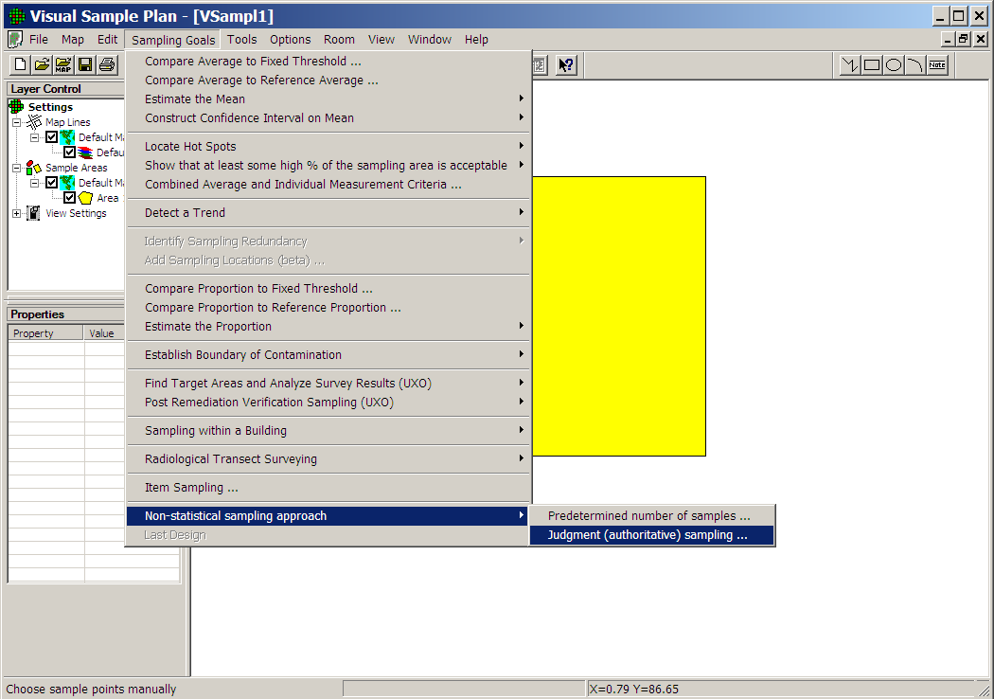
VSP
Sampling Goals
Non-statistical Sampling Approach
Judgmental Sampling

Slide 67
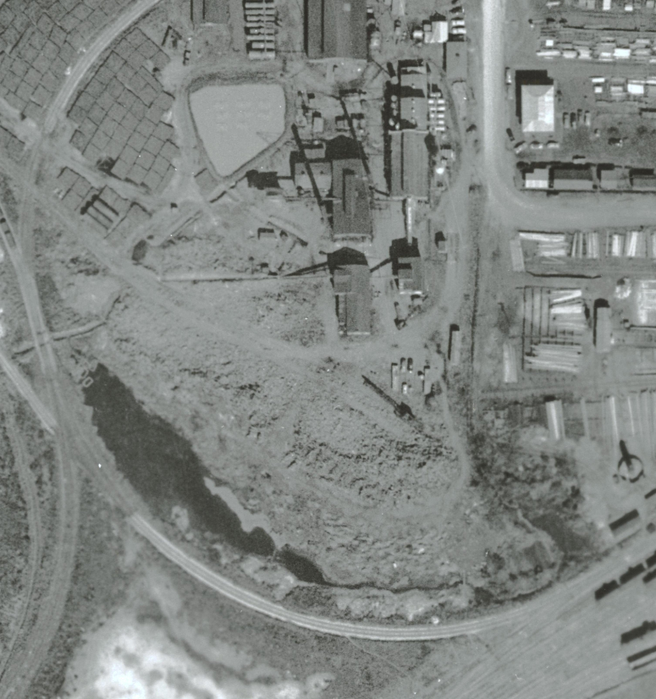
Judgmental Sampling: Example
Objective: determine if soil contamination is present anywhere along the former ditch
Initial Sampling Strategy: Sample soil where the CSM indicate contamination is most likely
Path of former ditch is displayed along historic aerial photo
1952
Notes:
12

Slide 68
Haphazard Sampling
Environmental units selected haphazardly with no clear objective in mind: Not acceptable
Samples selected because of convenience in time, space and/or cost
Often resulting in biased and redundant results
Not same as random sampling
Random sampling is geared toward unbiased and uncorrelated results

Slide 69
Probability-Based or Statistical Design Strategies
Applicable when:
Need to make technically defensible and reproducible decisions
Want to quantify potential decision errors
Want to achieve specified confidence and/or accuracy

Slide 70
Probability-Based or Statistical Design Strategies
Simple random
Systematic (grid)
Stratified
Multi-Increment
Perimeter (boundary)
Collaborative
Sequential (in time)
Adaptive Cluster

Slide 71
Probability-Based or Statistical Strategies: Strengths
Reliable
Makes full use of the CSM and other professional knowledge about the site
Quantifiable
Valid inferences based on sample data
Quantify accuracy and confidence
Reproducible
VSP software is available to help select and implement probability-based strategies

Slide 72
Probability-Based or Statistical Strategies: Weaknesses
Large number of strategies available can cause uncertainty about which one to use.
Need certain level of expertise to select the best strategy (Statistical Translation)
Many samples (high cost) may be needed to achieve desired low probabilities of making decision errors

Slide 73
Simple Random Sampling
Most common probability-based design
Aimed at producing “unbiased” data
Disadvantage
Can be inefficient if there are spatial or temporal patterns of contamination within the site
Often in environmental investigations random sampling has to be applied after dividing the site into homogenous zones, e.g. impacted v. clean zones (stratified random sampling)

Slide 74
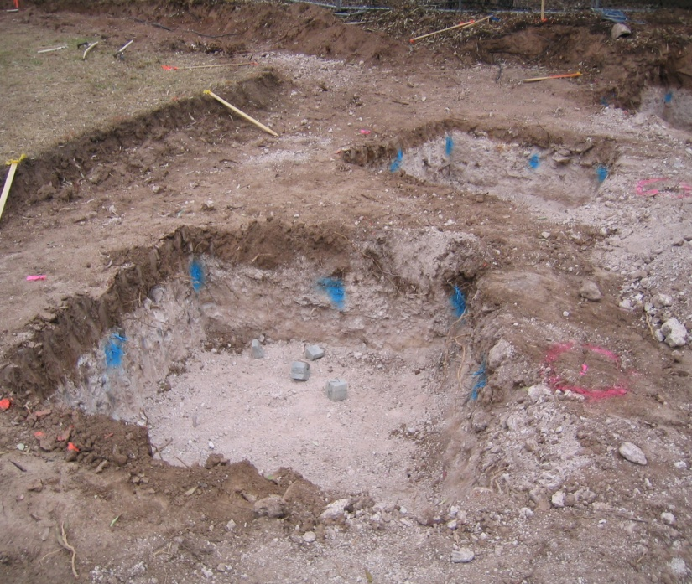
Example
Post Removal Sampling
Objective: Confirming the adequacy of removal
Arsenic contaminated soil has been removed
Are there any “significant pockets of contamination” left?

Slide 75
Example (Continued)
How might we define the target population of environmental units, and why?
The floors and walls of excavated areas?
Size and geometry of collected samples?
What statistical parameter should be used to confirm attainment of cleanup?
The mean arsenic concentration over the excavated area?
Highest measured arsenic?

Slide 76
Example (Continued)
Hypotheses Selected
H_{o}: true mean arsenic ≥ 19 mg/kg
H_{a}: true mean arsenic < 19 mg/kg
Decision Rule Selected
If: reject H_{o}
Then: excavation is complete
Otherwise: remove another layer of soil

Slide 77
Example (Continued)
Since true mean is not known, then rely upon the conservative estimate of the mean arsenic concentration
95%UCL
Hypotheses Selected
H_{o}: 95%UCL ≤ 19 mg/kg
H_{a}: 95%UCL > 19 mg/kg

Slide 78
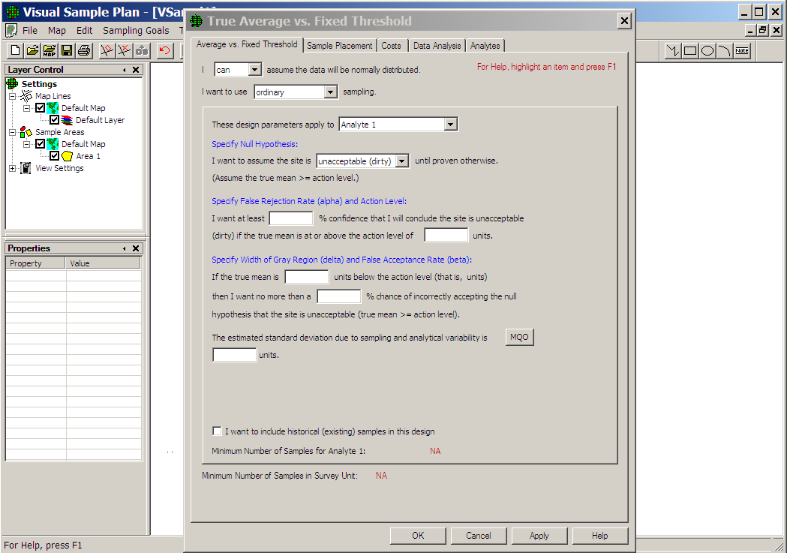
Use VSP to
Determine n
Assume data will
be normally
distributed
“Ordinary” sampling
Null Hypothesis
Select “Compare Average to
Fixed Threshold…” as the
sampling goal
Simple Random Sampling

Slide 79
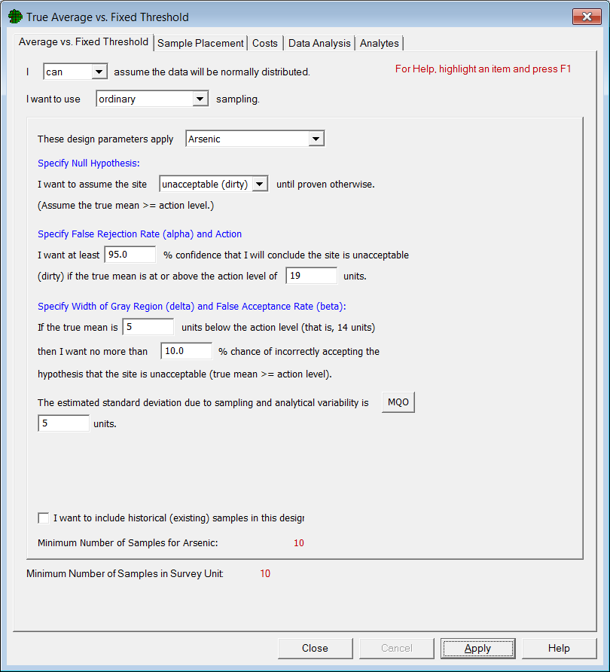
H_{o}: true mean arsenic ≥ 19 mg/kg
α = 0.05
Action Level = 19 mg/kg
Width of the Gray Region = 5
Alternative Level = 14
β = 0.10
Standard Deviation = 5 mg/kg
Number of Samples = 10

Slide 80
Decision Performance Goal Diagram
α = 0.05
Standard Deviation = 5
Alternative Level
Width of Gray Region
Action Level
β = 0.10

Slide 81

10 Randomly Selected Locations

Slide 82
Suggested Reading
Department of the Navy (DON). 2002. Guidance for Environmental Background Analysis, Volume I: Soil. NFESC User’s Guide UG-2049-ENV. Washington, DC: Naval Facilities Engineering Command. April.
Department of the Navy (DON). 2003. Guidance for Environmental Back­ground Analysis, Volume II: Sediment. NFESC User’s Guide UG-2054-ENV. Washington, DC: Naval Facilities Engineering Command. April.
Department of the Navy (DON). 2004. Guidance for Environmental Back­ground Analysis, Volume III: Groundwater. NFESC User’s Guide UG-2059-ENV. Washington, DC: Naval Facilities Engineering Command. April.
Department of the Navy (DON). 2011. Guidance for Environmental Back­ground Analysis, Volume IV: Vapor Intrusion Pathway. NFESC User’s Guide UG-2091-ENV. Washington, DC: Naval Facilities Engineering Command. April.
Gilbert, R.O. 1987. Statistical Methods for Environmental Pollution Monitoring. New York: Van Nostrand Reinhold.
Helsel, D.R., and R.M. Hirsch. 1992. Statistical Methods in Water Resources. New York: Elsevier.
United States Environmental Protection Agency (U.S. EPA). 1989. Statistical Methods for Evaluating the Attainment of Cleanup Standards, Vol. 1: Soils and Solid Media. EPA 230/02-89-042. Washington, DC: Office of Policy, Planning, and Evaluation.
United States Environmental Protection Agency (U.S. EPA). 1989. Methods for Evaluating the Attainment of Cleanup Standards, Vol. 2: Groundwater. EPA 230-R-92-14. Washington, DC: Office of Policy, Planning, and Evaluation.
United States Environmental Protection Agency (U.S. EPA). 1992a. Statistical Analysis of Ground-Water Monitoring Data at RCRA Facilities – Addendum to Interim Final Guidance. Washington, DC: Office of Solid Waste, Permits and State Programs Division. June.
United States Environmental Protection Agency (U.S. EPA). 1992b. Supplemental Guidance to RAGS: Calculating the Concentration Term. EPA Publication 9285.7-081. May.
United States Environmental Protection Agency (U.S. EPA). 1994b. Statistical Methods for Evaluating the Attainment of Cleanup Standards, Vol. 3: Reference-Based Standards for Soils and Solid Media. EPA 230-R-94-004. Washington, DC: Office of Pol­icy, Planning, and Evaluation.

Slide 83
Next Steps
Part 1. Introduction/Sampling Design
1 day/Software: DOE’s VSP
Part 2. UCL and Background Analyses
2 days/Software: EPA’s ProUCL/Scout
Part 3. Univariate Techniques: ANOVA
2 days/Software: IBM SPSS
Part 4. Multivariate Techniques: PCA/PLS
2 days/Software: IBM SPSS
Part 5. Geostatistics
2 days/Software: ArcGIS Geostatistical Analyst

